Slide 1

CVS Health Foundation CATCH My Breath
Training
As part of the
Plymouth State University
PEHE Teacher Certification Program CVS Grant
Notes:
NOTE:
To change the image on this slide, select the picture and delete it. Then click the Pictures icon in the placeholder to insert your own image.

Slide 2



Introductions
PSU CATCH My Breath Team
Colby Batkins is a graduate student in the Clinical Psychology program and is the Graduate Assistant for the CATCH My Breath grant. Colby will be helping manage and implement the Grant requirements through Summer 2020.
Tim Losee, PhD is an Assistant Professor in the PE and PEHE Teacher Certification program. Dr. Losee is the Principal Investigator for the PSU CATCH My Breath Grant.
Irene Cucina, DPE is the PE and PEHE Teacher Certification Program Coordinator at PSU. Dr. Cucina is responsible for the CATCH My Breath training for the 2020 Interns, Pre-Service Teacher Candidates, and NH PE/HE Teachers involved in the Grant.

Slide 3
Training Materials
Packet of Information

Slide 4
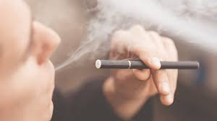
PRE ASSESSMENT - Knowledge, Attitudes, and Experiences with E-Cigarettes
Go to www.socrative.com
Click on “student login” and enter room name (EAUNKG2)

Slide 5

Purpose of the CATCH My Breath Program
CATCH My Breath is an e-cigarette and JUUL prevention program that provide students with the skills to resist peer pressure and media influences to try e-cigarettes.
The lesson can be taught during a normal class period, during homeroom/advisory, after-school, or at other non-school activities and clubs.
To learn more about CATCH programs, materials, and training, visit the CATCH Global Foundation website (http://catchinfo.org/).

Slide 6
CATCH Curriculum Goals
Discover that non-use of e-cigarettes is the norm for adolescents
Identify reasons why young people might start using e-cigarettes
Recognize the subtle, and not so subtle, messages in e-cigarette advertising
Practice skills for resisting peer pressure and advertising pressure to use e-cigarettes
Decide on their personal reasons not to use e-cigarettes and set goals for future non-use

Slide 7
Intended Outcomes of Curriculum
Student will be able to (SWBAT):
Resist their own curiosity, peer and advertising pressure to experiment with e-cigarettes
(Understand) Describe that e-cigarettes are addictive, unhealthy, and not as popular as they think
Influence friends and peers not to use e-cigarettes

Slide 8
Program Structure
4 unique lessons for each grade group
Lessons are approximately 35 minutes long.
Materials provided include: lesson plans with learner outcomes, a detailed outline of directions, and corresponding PowerPoint presentations.

Slide 9
CATCH My Breath
Based on Skills Based Health model
Uses participatory learning strategies
Emphasizes functional health knowledge
Health related skills taught through content (vaping)
  Disrupting the norm held by youth that most teens smoke e-cigarettes
  Developing skills to resist peer pressure and advertising pressure to use e-cigarettes
  Understanding how advertising is designed to undermine credible health information
  Creating favorable non-smoking attitudes and beliefs about e-cigarettes

Slide 10
GRADES 5 – 6 Sequence of Lessons
Lesson Focus | Lesson Objectives
Session 1: Consequences of using e-cigarettes | Identify negative consequences of e-cigarette use. Describe the health hazards associated with e-cigarette use. Analyze the safety of flavor chemicals and their role in e-cigarette marketing. Analyze basic ingredients in e-liquid.
Session 2: Making our own choices | Identify the percentage of e-cigarette users in middle school and high school and describe nonsmokers as the majority. Describe the harmful consequences of e-cigarette use. Identify reasons why teens may begin using e-cigarettes. Identify positive alternatives to using e-cigarettes. Develop, practice and demonstrate refusal skills and smart exit strategies. Interview an adult regarding tough choices and tobacco use.

Slide 11
Grades 5 – 6, continues
Lesson Focus | Lesson Objectives
Session 3: Don’t let them lie and win | Recognize situations and places that may be high-risk for being offered an e-cigarette. Discover the amount of money the tobacco and e-cigarette industry spends on advertising its products. Describe the role of advertising dollars in e-cigarette use. Recognize indirect and direct advertising strategies. Recognize the covert methods that the tobacco and e-cigarette industry uses to attract new e-cigarette users. Analyze some of the propaganda techniques tobacco and e-cigarette companies use to sell their brand of e-cigarette. Develop a messaging project (warning label) that addresses misconceptions and promotes the benefits of being e-cigarette-free.
Session 4: Your Life. Your Choice. | Review the covert methods that the tobacco and e-cigarette industry uses to attract new e-cigarette users. Develop and present a messaging project (warning label) that addresses misconceptions and promotes the benefits of being e-cigarette-free. Make a personal goal regarding e-cigarette use.

Slide 12
GRADES 9-12 Sequence of Lessons
Lesson Focus | Lesson Objectives
Session 1: Designed for addiction | Understand the highly-addictive nature of nicotine. Describe the health hazards associated with e-cigarette use. Identify the health and social consequences of e-cigarette use.
Session 2: What could go wrong? | Identify existing knowledge or perceptions of e-cigarettes. Dispel misconceptions about e-cigarettes. Synthesize information about the health and social consequences of using tobacco products such as e-cigarettes. Discover ways to quit using tobacco products (including e-cigarettes) and support peers who want to quit by offering encouragement and referring cessation resources to them.

Slide 13
GRADES 9-12, continued
Lesson Focus | Lesson Objectives
Session 3: Co-create & hack the system | Learn about laws, rules and regulations regarding tobacco and e-cigarettes. Discuss the reason behind such rules and how it applies to youth. Understand that they can participate actively in such policy making.
Session 4: Take Control of Your Life | Learn to create laws and rules regarding tobacco and e-cigarette. Learn to communicate policies to governing agencies.

Slide 14
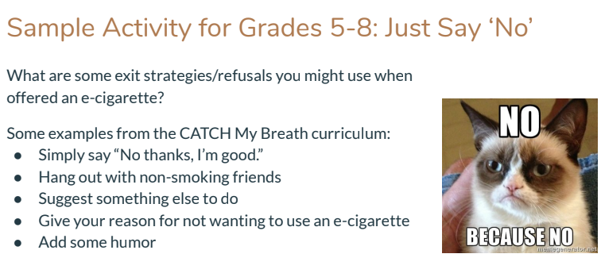
Demonstration of Sample activity
Notes:
3 min

Slide 15
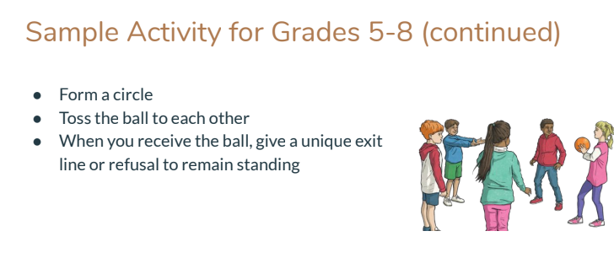

Slide 16
Sample Activity for Grades 9 – 12
Negative Consequences of Using E-Cigarettes
Explain: E-cigarettes are not harmless and have lots of health and social consequences associated with using them.
Instruct students to find a partner and get toe-to-toe with them
One partner will exchange a health consequence and the other will exchange a social consequence
The students will then do the activity listed on the board associated with the consequence
One you have completed the exchange of consequences and physical activity, you will march in place until I say SWITCH.
When I say SWITCH, you will run and get toe-to-toe with a new partner and exchange health and social consequences again.
We will repeat this activity five times.

Slide 17
Health consequences
Aerosol has toxic chemicals that can damage the lungs: arm pumps (pump both of your arms over your head).
Hacks your brain (dopamine reward system, impulse control center): high knees
Nicotine causes addiction: standing oblique crunches (stand up with your heels together and your toes pointed outward. Extend one arm straight up above your head and place the other hand on your waist for balance. Bring your elbow and knee together, then return to the starting position)
Dry mouth, Vapor tongue, Sore throat, Nose bleed: calf raises (raise heels off the floor, then slowly lower them)
Nicotine toxicity: nausea, headache, increased heart rate: wall push-ups
Can be fatal for babies (SIDS, stillbirth, low birthweight): march in place
Batteries explode: squats
Gateway to combustible tobacco, alcohol and marijuana and other addictive drugs: hop in place
Ingesting e-liquid can be FATAL: jumping jacks

Slide 18
Social Consequences
Costs a lot of money, about $50 to get started: jumping jacks
Cartridge pods cost $3- $7 (per pod): hop in place
Get suspended from sports/school: squats
Bad role model to younger family members: calf raises (raise heels off the floor, then slowly lower them)
Get in trouble at school or at home: march in place
Get in trouble with the law (Purchasing or possession is against the law under 18 or 21 depending on state): standing oblique crunches (stand up with your heels together and your toes pointed outward. Extend one arm straight up above your head and place the other hand on your waist for balance. Bring your elbow and knee together, then return to the starting position)
Lose the trust of parents: arm pumps (pump both of your arms over your head)

Slide 19
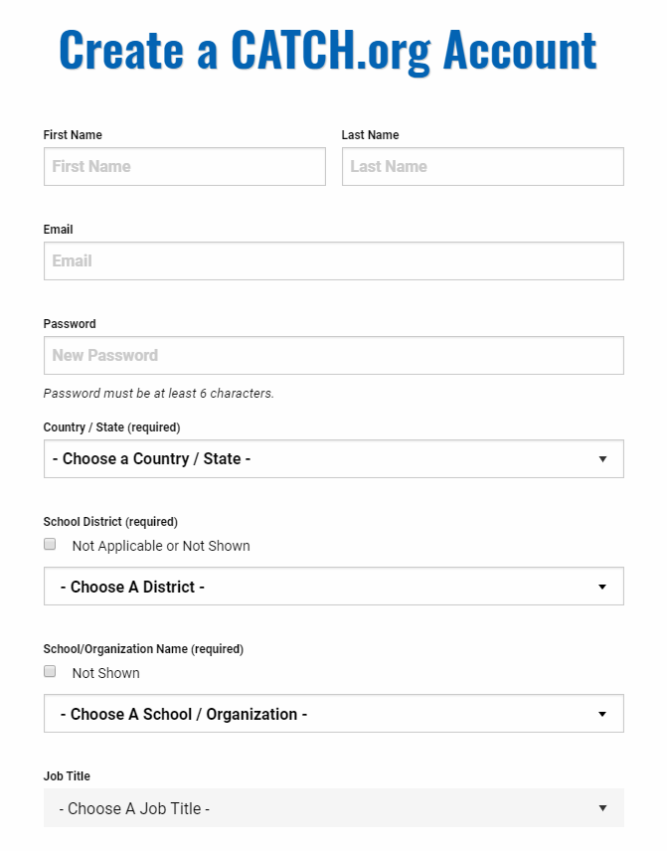
Set up CATCH My Breath Accounts
Website: https://www.catch.org/users/sign_up

Slide 20
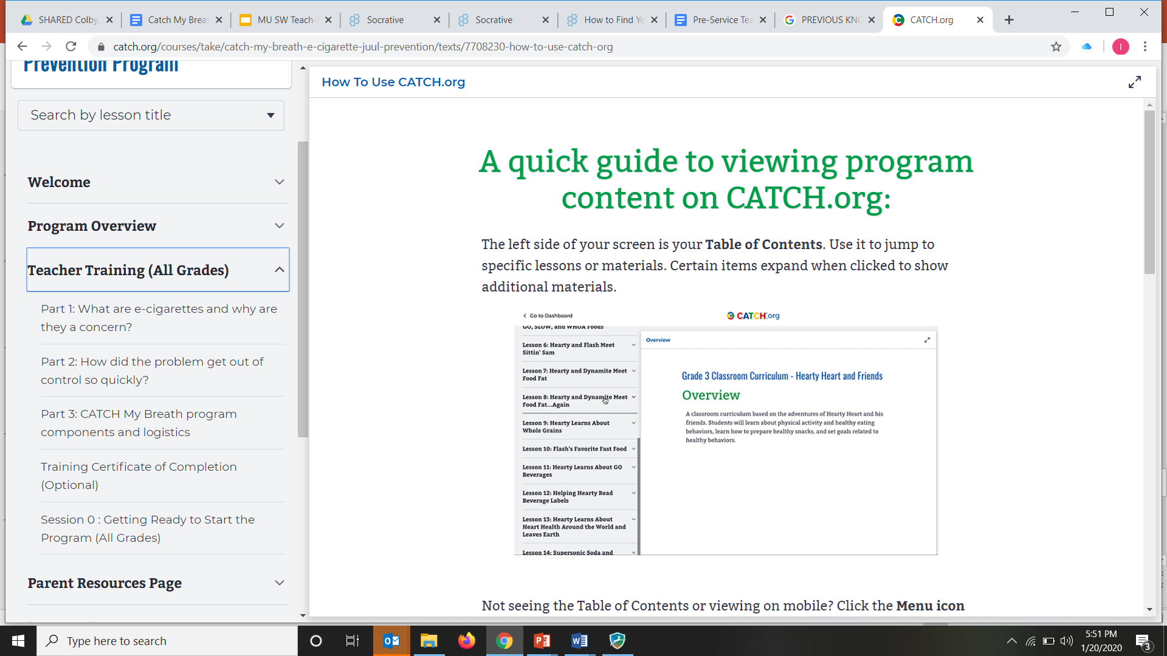

Slide 21
Other Information
Letter for parents (allows to opt out of taking pre/post survey)
Pre- and post-survey will need to be administered to your classrooms (Program Resources → Evaluation Tools)
  Post-survey should be given at least one week after the last lesson is taught
Teacher Feedback Survey
Teacher Reporting Form
Maintain integrity of program by teaching lessons as written.
  If add projects or assignments; do after you administer the final post survey assessment.
Allow our Teaching Interns to teach the lessons as described
Allow our Methods students to assist with the teaching of the lessons.

